Slide 1

Trends and Opportunity
CFIs Membership Drive in Africa

Slide 2

ACCOSCA IS COMMITTED TO EMPOWERING PEOPLE LIVING IN AFRICA
THROUGH FINANCIAL CO-OPERATIVES
ACCOSCA LEADERSHIP SHOWING THEIR SOLIDARY THAT OUR MISSION REMAINS CONSTANT

Slide 3
Tunisia
Morocco
Mature Stage
Algeria
SACCO FOOT PRINT IN AFRICA
Western Sahara
(Morocco)
Libya
Egypt
Ghana-CUA
Gambia-NACCUG
Cameroon- CAMCUL
Seychelles- SCU
Kenya- KUSCCO
Malawi- MUSCCO
Zimbabwe- NASCUZ
Botswana- BOSCA
Eswatini- ESASCCO
Tanzania- SCCULT
Mauritania
Senegal
Niger
Sudan
Eritrea
Djibouti
The Gambia
Mali
Burkina
Faso
Chad
Guinea-Bissau
Guinea
Benin
Nigeria
Ethiopia
Sierra Leone
Côte
d'Ivoire
Togo
Central African
Republic
NASCENT STAGE
Liberia
Ghana
South Sudan
Cameroon
Somalia
B=Burundi
DRC-COPEC NYAWERA
Nigeria- CFAN
Ethiopia- AASCCU
Sierra Leone- NACCUA
South Africa- NACFISA
Uganda- UCSCU
Lesotho-
Zambia- NACUZ
Rwanda- AMIR
South Sudan
EG
Uganda
EG=Equatorial Guinea
São Tomé
and Príncipe
Gabon
Kenya
L=Lesotho
Congo Republic
DR Congo
R
B
R=Rwanda
Tanzania
S=Swaziland
Comoros
Mayotte (France)
Seychelles
Angola
Malawi
MFI/SACCOS
Zambia
Mozambique
Mali
Guinea- Bissau
Burkina Faso
Cote D’Ivoire
Togo
Benin
Equatorial Guinea
Senegal
Namibia
Namibia
Zimbabwe
Madagascar
Botswana
S
L
South Africa

Slide 4
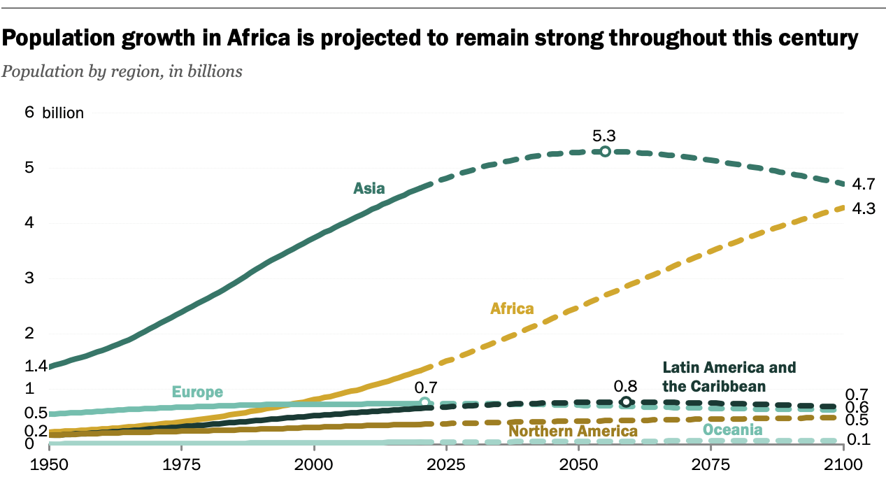

Slide 5
Key Obstacles to Membership Growth
DISRUPTION
Poor Image of SACCO Business Model in Some Countries adversely ability to attract new members
Poor Representation of National demographic
Focus on Formal Sector
High Gender Disparity
Lack of Credible Statistical information to back the impact of SACCOs in the population
Governance Issues affecting efficiency level and ability to effectively service members

Slide 6

Failure to get the Balance between Business and Social Mission
Business Strategies
Social Values
SACCO STABILITY

Slide 7
Integrated Network:
An Integrated Network for SACCO/ CFIs
“Integrated model allows credit union networks to perform better in terms of market penetration, stability, financial efficiency, service extension and members.” Examples: Desjardins Group and Korean credit unions
It is the responsibility of Board and Management of CU to ensure SACCOs/CFI grow

Slide 8
Vision: Integrated & Sustainable Credit Union Networks
National
Network Development & Sustainability
Provincial
Coop
Network Management
CFIs/SACCO
Deliver Quality services
Improve lives of people
MEMBERS
Life Goals & Objectives satisfied
Notes:
In an integrated network, credit unions elevate the role of developing infrastructure, systems, procedures and programs so that credit unions would be able to concentrate in delivering quality services to their members. The federation manage the growth and sustainability of the network.

Slide 9
OPPORTUNITIES FOR GROWTH
04
Advocacy, Governance & Policies
Virtual Sessions.
GROWTH: FOCUS ON SAFETY AND SOUNDNESS
Rethinking SACCO Business Model- Capital Adequacy, Assets Quality, Profitability ,Liquidity ,Growth projections
Develop a Proactive Engagement with Regulators: Policy formulation and amendments
Digitalization and enhance Share platformed:
Adopt effective Performance Tools:
Launch Webinars Series
02
Financial Stability and sustainability
Reduced Staff Salaries by 10%
Execute programs online at nominal fees
Raise Capital through Support initiatives
01
06
Membership
Human Resource
Low Drive
Voice Project
Volunteers Trainers
Improve Staff Training Capacity
07

Slide 10
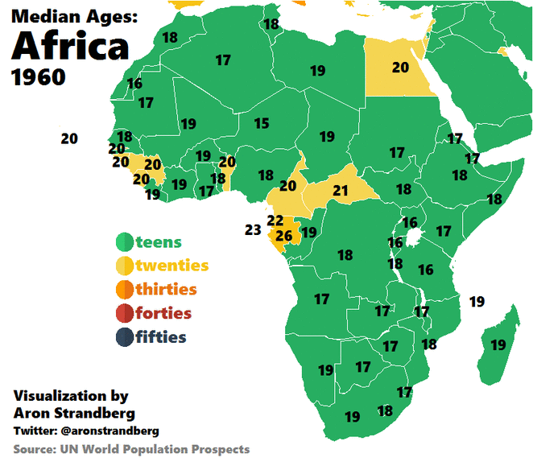
Mainstreaming Youth and Gender in Membership Drive

Slide 11
Opportunities to Membership Growth
DISRUPTION
Improve CFI Business Model- to attract new members
Rural and Urban CFIs
Focus on both informal and Formal Sector
Deliberate measures for Gender Equality
Credible Statistical information to back the impact of SACCOs in the population
Improve Governance Issues affecting efficiency level and ability to effectively service members

Slide 12
04
Advocacy, Governance & Policies
Virtual Sessions.
THANK YOU
Launch Webinars Series
02
Financial Stability and sustainability
Reduced Staff Salaries by 10%
Execute programs online at nominal fees
Raise Capital through Support initiatives
01
06
Membership
Human Resource
Low Drive
Voice Project
Volunteers Trainers
Improve Staff Training Capacity
07

